Slide 1
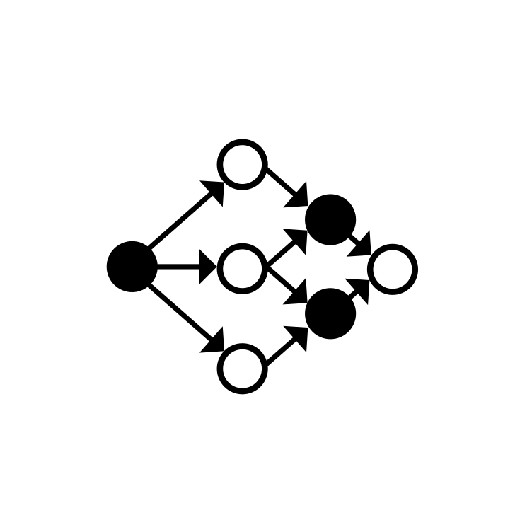
Dependency Injection
2023-24

Slide 2
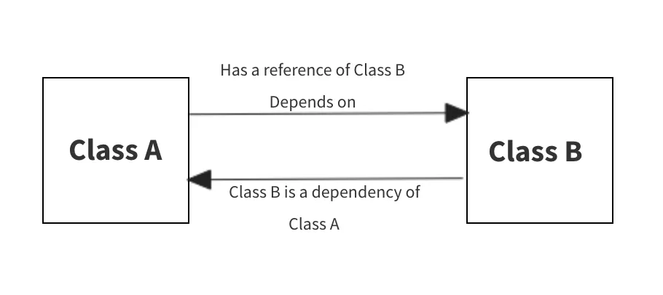
Dependencies
Objects are often based on the delegation pattern
Part of their behaviour is delegated to some other objects they refer to
These objects, the behaviour is delegated to, are named dependencies
In order to delegate, a suitable instance of the dependent class should be available
The constructor of the delegating class is usually in charge of providing such instances

Slide 3
Managing dependencies
Having a class providing its own dependencies has several disadvantages
The class-coupling level increases: it is not possible to compile, test, run one class if the other class is not available
If the dependency need some configuration parameters, these must be provided where it is constructed, i.e., in the enclosing class
It is cumbersome to make two different (possibly unrelated) objects share a common dependency
Code reuse is hampered
Class coupling can be mitigated by introducing a level of indirection
The enclosing class may refer to its dependencies via interfaces, that abstract the actual behaviour
Constructor parameters may be used to provide the actual implementations

Slide 4
Managing dependencies
class MyRepository(private val context: Context) {
val myModel = MyDatabaseImpl.getDb(context)
val myApi = MyApiImpl("https://myhost.com/api/v1")
//… more code
}
1
2
3
A Context is needed to create the database
A hard dependency on two concrete classes is introduced (MyDatabase, MyApiImpl)
Details about the location of the API server need to be known here

Slide 5
Refactoring to reduce class coupling
interface MyDatabase { … }
@Database
class MyDatabaseImpl(context: Context):
RoomDatabase(context), MyDatabase { … }
interface MyApi{ … }
@Database
class MyApiImpl(baseURL: string): MyApi { … }
class MyRepository(val myDb: MyDatabase, val myApi: MyApi) {
//… more code
}

Slide 6
Injecting content
While refactoring has reduced the static coupling between classes, a new issue is now present:
Who is responsible of providing the actual implementations of the two interfaces required by the MyRepository class?
In these situations, dependency injection frameworks come to the rescue
Dependencies injection is a design pattern that aims to separate the concern of constructing objects from the one of using them
Between the client class (the one that has dependencies) and the dependencies a third actor steps in: the dependency injection framework
This takes care to find out what concrete class should provided as a construction parameter to a client class and how to locate or construct actual instances of those classes

Slide 7
Dependency injection in Android
Several DI frameworks exist for the Java/Kotlin ecosystem, some specifically aimed at Android and other at a more general programming environment
Spring — based on a central piece of software, the ApplicationContext, that is responsible for instantiating, configuring, and assembling objects at runtime, as well as managing their life cycles
Dagger — operates at compile time and produces static code where dependencies are resolved and wired
Dagger2 — Build on top of Dagger, created by Google Team
Koin — A runtime DI framework, completely written in Kotlin
Hilt — build on top of Dagger2, completely focused on Android
Frameworks often use annotations to label classes and their dependencies
Both to express the role played by a class and to mark the place where the dependency should be injected

Slide 8
Hilt
Hilt is a DI library that generates code at compile time relying on a set of annotations
It requires several dependencies, both in the project build.gradle file and in the app module one
buildscript { …
dependencies { …
classpath "com.google.dagger:hilt-android-gradle-plugin:2.44"
}
} plugins { …
id 'com.google.dagger.hilt.android' version '2.44' apply false
}
project: build.gradle

Slide 9
Hilt
plugins { …
id 'kotlin-kapt'
id 'com.google.dagger.hilt.android'
}
dependencies { …
implementation 'com.google.dagger:hilt-android:2.44'
kapt 'com.google.dagger:hilt-compiler:2.44'
}
// Allow references to generated code
kapt {
correctErrorTypes true
}
app: build.gradle

Slide 10
Hilt annotations
The project should define a custom Application subclass labelled with @HiltAndroidApp
It triggers Hilt code generation and includes the base class for the application that serves as the application-level dependency container
It will store a reference to all the singleton dependencies as well as
Android components (services, activities, fragments, views, broadcast receivers) relying on DI should be labelled with @AndroidEntryPoint

Slide 11
Hilt annotations
@HiltAndroidApp
class MyHiltApp : Application()
@AndroidEntryPoint
class MainActivity : AppCompatActivity {
@Inject lateinit var player: MusicPlayer
//…
}
class MusicPlayer @Inject constructor() {
fun play(id: string) {
//…
}
}

Slide 12
Hilt annotations
Dependency injection can happen in two ways:
Via constructor injection - In this case the dependency is provided to the constructor as a parameter
Via property injection - This happens when a lateinit var property is declared and not initialized
To inject a dependency, the destination must be labelled with @Inject
In case of constructor injection, it is the constructor that must be annotated, independently of how many parameters it declares
Hilt selects what value to store in these variables using different criteria
If the variable has a concrete type, and the type has a no-arg constructor, it is possible to decorate the primary constructor of the dependency with the @Inject annotation (again!)
Otherwise, a @Module class need to be defined

Slide 13
Scopes
Sometimes, an app need that the same dependency is used in all places where an object of that kind is required
This can easily be achieved adding an extra annotation to the dependency class: @Singleton
It is also possible to constrain creating different instances of a dependency per each high-level Android component (e.g, activity or service)
Via @ActivityRetainedScoped, @ViewModelScoped, @ActivityScoped, @ServiceScoped
Or to limit the scope of a dependency to each view or fragment instances
Via @ViewScoped, @FragmentScoped
If no scope is indicated, a new instance of the dependency will be created per each requesting client

Slide 14
Components lifecycle
The lifecycle of a dependency varies according to its scope
@Singleton - Application::onCreate() → Application::onTerminate()
@ActivityRetainedScoped - Activity::onCreate(...) → Activity::onDestroy() (objects survive the destructions due to configuration changes)
@ViewModelScoped - ViewModel::<init> → ViewModel::onCleared()
@ActivityScoped - Activity::onCreate(...) → Activity::onDestroy()
@FragmentScoped - Fragment::onAttach(...) → Fragment::onDetach()
@ViewScoped - View construction → View destruction
@ServiceScoped - Service::onCreate() → Service::onDestroy()

Slide 15
Hilt modules
A Hilt module is a class annotated with @Module
Methods annotated with @Provides are used by the framework to provide instances of a given type (actual class or interfaces)
Function parameters are used to supply transitive dependencies needed by the instance to be provided
A module is also annotated with @InstallIn: this defines which dependency container will be used to store the provided instances
This defines to what kind of Android component the provided instances will be available
Hilt defines 8 possible containers, reflecting the possible injection scopes

Slide 16
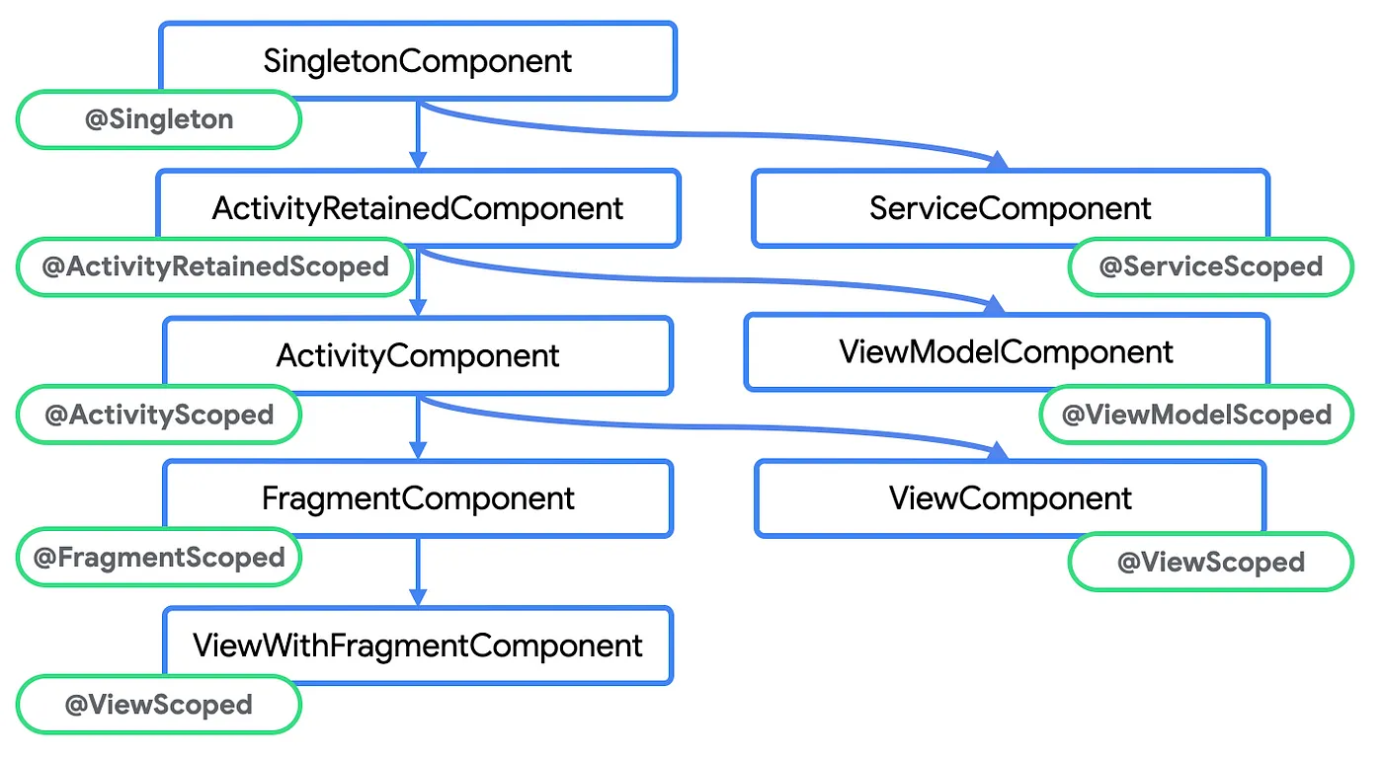
Hilt dependency containers

Slide 17
Hilt module example
class MusicPlayer @Inject constructor(
private val db: MusicDatabase//this is an interface! It prevents direct injection
) {
fun play(id: string) { … }
}
@Module
@InstallIn(SingletonComponent::class)
class MusicModule {
@Singleton // any class needing this dependency will get the same instance
@Provides
fun provideMusicDB(@ApplicationContext context: Context): MusicDatabase {
return Room.databaseBuilder(context, MusicDatabase::class.java, "music.db")
.build()
}
}

Slide 18
Jetpack integration
Hilt offers integrations with several Jetpack libraries
ViewModel, Navigation, Compose, WorkManager, …
In the case of ViewModels, classes must be annotated with @HiltViewModel
If they need any dependency, their constructor should be annotated with @Inject
@HiltViewModel
class MyViewModel @Inject constructor(
private val adapter: AnalyticsAdapter,
private val state: SavedStateHandle
): ViewModel() {
//...
}

Slide 19
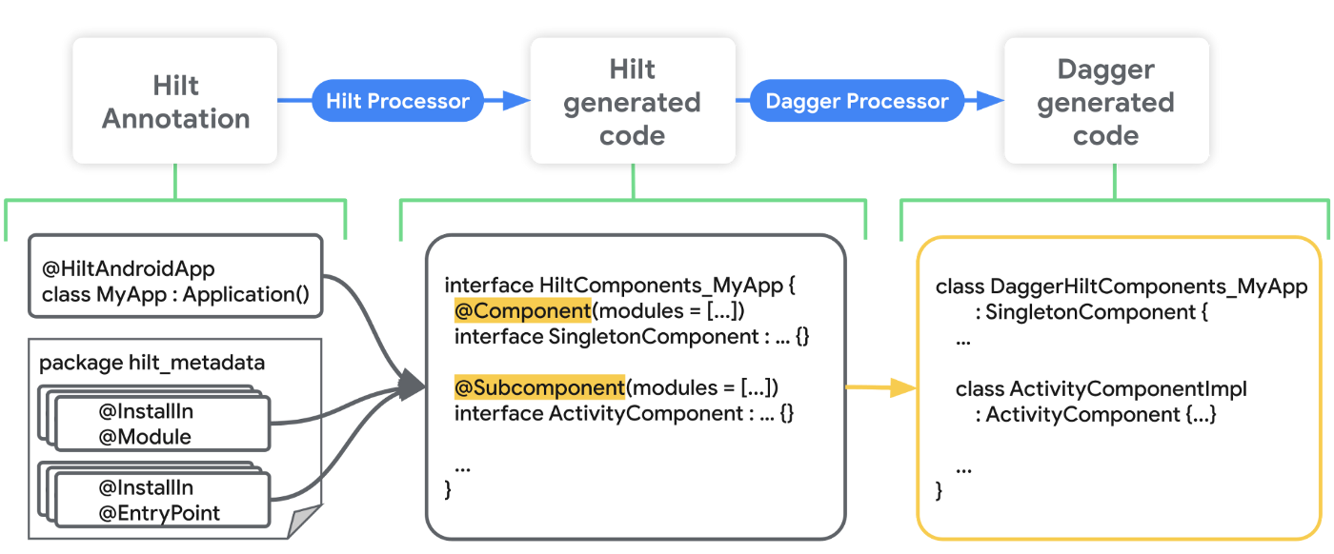
Generated code
https://medium.com/androiddevelopers/mad-skills-series-hilt-under-the-hood-9d89ee227059

Slide 20

Learning more…
Differences and Advantages of Hilt, Dagger2, Koin
https://medium.com/huawei-developers/differences-and-advantages-of-hilt-dagger2-koin-1-3af44e9a0722
Basics of Dependency Injection in Android using Hilt
https://write.agrevolution.in/dependency-injection-in-android-with-hilt-part-1-6c19d06ec2bd
Creating ViewModel dependencies using Hilt
https://medium.com/codex/creating-viewmodel-dependencies-using-hilt-ff8005488910
Creating the Network Module with Hilt
https://medium.com/codex/creating-the-network-module-with-hilt-3eefc54b72
Using Hilt (Dependency Injection) To Provide Network & Room Instance
https://medium.com/dwarsoft/using-hilt-dependency-injection-to-provide-network-room-instance-6245172c5a57

